Slide 1
SECURE PASSWORD GENERATOR
A CYBER SECURITY PROJECT
TEAM:
PRANAY
CHENNA REDDY
JALANDHAR
NARASIMHA

Slide 2
PROJECT INFORMATION
We have done a secure password generate
It takes input parameters from the user according to their requirements
And it displays strong password

Slide 3
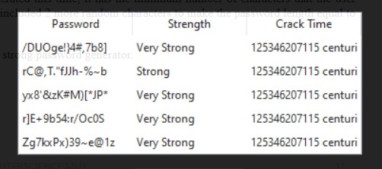
DEMO PICTURES

Slide 4
ADDITONAL FEATURE
We have added some additional features to our project
Along with the generated password we also displays the strength of the password
Also we have given option of choosing how many number of passwords to be generated for the user
We add a save option to store the generated passwods

Slide 5
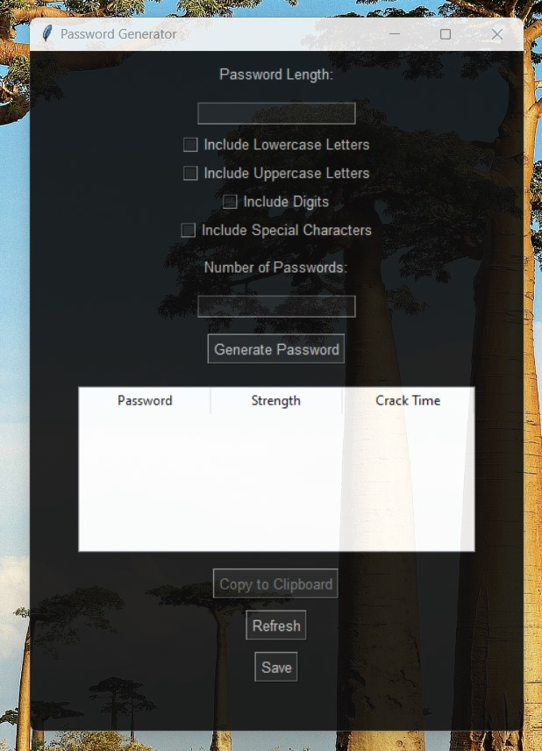
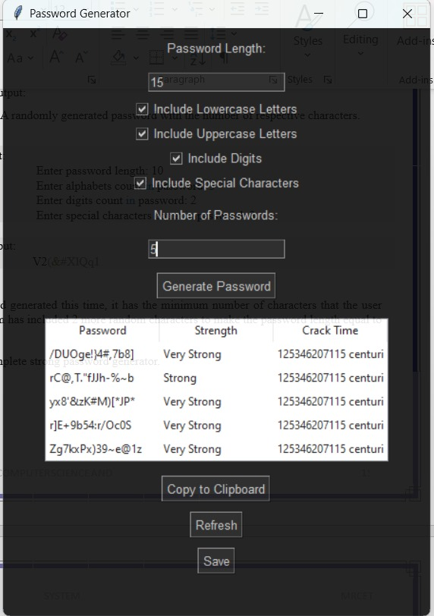
Number of passwords generated
Strength of the passwrod

Slide 6
CONCLUSION
This project’s main goal is to provide a strong and secured password for the customer
So that they can keep their account more secure
Also they will be protected from the Cyber Attacks

Slide 7
THANK YOU

